Slide 1
Open the black box
Chris Kuo, Ph.D.| Columbia University

Slide 2
What is GBM?
Statement of the problem
Notes:
This is the question that your experiment answers

Slide 3
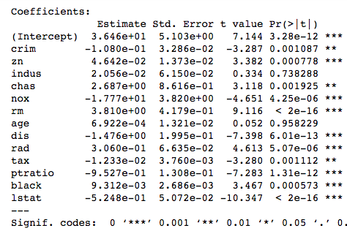
In a linear regression
The variable significance: X is statistically significant at 95% level.
The sign of the coefficient: tells your audience “there is a positive/negative relationship between X and Y.
R2=74%
What do you do with Machine Learning results?

Slide 4
(1) Variable importance
This plot provides a list of the most significant variables in descending order by a mean decrease in Gini.
The top variables contribute more to the model than the bottom ones.
All machine learning techniques
Relative influence (change in Gini)

Slide 5
(2) Partial dependence plot
A partial dependence plot can show the direction between X and Y.
Given multiple predictors, the idea to understand the influence of a single predictor is to “average out” the influence of other predictors.
Friedman( 2001)
There is a negative relationship between X and Y.

Slide 6
(2) Partial dependence plot
A partial dependence plot can show the direction between X and Y.
Given multiple predictors, the idea to understand the influence of a single predictor is to “average out” the influence of other predictors.
Friedman( 2001)

Slide 7
Gradient descent
Statement of the problem
Notes:
This is the question that your experiment answers

Slide 9
What is GBM?
Statement of the problem
Notes:
This is the question that your experiment answers

Slide 10
What is GBM?
Statement of the problem
Notes:
This is the question that your experiment answers

Slide 11
Work cited
Autoencoders were first introduced in the 1980s by Hinton.
Notes:
Summarize your research in three to five points.

